Slide 1

COLLABORATIVE CLASS PROJECT: ROBOT CONTROL
Kevin Carrion
Matteo Mastromauro
Alexandra Spertini
Alex Zagati

Slide 2
OUTLINE
0. INTRODUCTION
NONLINEAR SYSTEM SIMULATION
SYSTEM LINEARIZATION AND STABILIZATION CONTROL SCHEME
IMPLEMENTATION OF THE CONTROL SCHEME ON REAL SYSTEM
FEEDBACK LINEARIZATION
ANALYSIS OF RESULTS
VARIABLE STRUCTURE CONTROLLER
VSC PERFORMANCE WRT CHANGE OF CONDITIONS

Slide 3
0. INTRODUCTION
The goal of the project was to apply some nonlinear control techniques and concepts on a simple robotic arm, made of a drive actuating a shaft through a flexible joint.

Slide 4
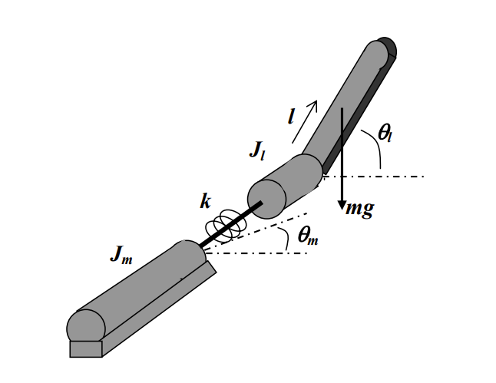
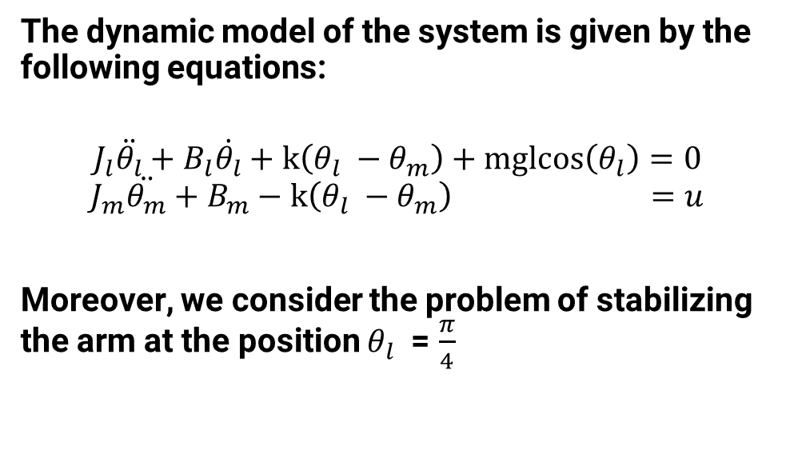
0.1 DYNAMICAL EQUATIONS
The dynamic model of the system is given by the following equations:
$$J_{l}\ddot{θ_{l}}+B_{l}\dot{θ_{l}}+k\left(θ_{l} −θ_{m}\right)+mglcos\left(θ_{l}\right)=0$$
$$J_{m}\ddot{θ_{m}}+B_{m}−k\left(θ_{l} −θ_{m}\right) =u$$
Moreover, we consider the problem of stabilizing the arm at the position $θ_{l}$ = $\frac{π}{4}$

Slide 5
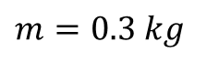
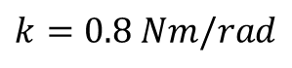
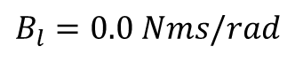
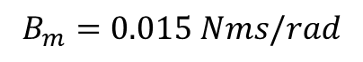
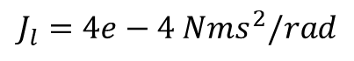
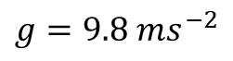
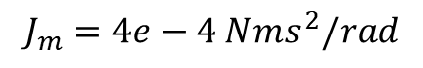
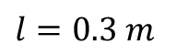
0.1 DYNAMICAL EQUATIONS
Model parameters:
$$k=0.8 Nm/rad$$
$$J_{m}=4e−4 Nms^{2}/rad$$
$$J_{l}=4e−4 Nms^{2}/rad$$
$$B_{m}=0.015 Nms/rad$$
$$B_{l}=0.0 Nms/rad$$
$$m=0.3 kg$$
$$l=0.3 m$$
$$g=9.8 ms^{−2}$$

Slide 6
1. STATE SPACE REPRESENTATION AND SYSTEM SIMULATION
At this stage, we focus on giving a state space representation of the system in order to simulate it in the Simulink environment, verifying that the system is unstable

Slide 7

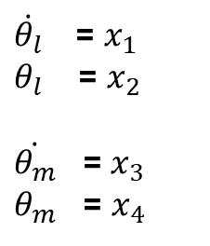

1.1 STATE SPACE REPRESENTATION
In order to give a state-space representation of the system, we must set:
$$\dot{x_{1}}=−\frac{B_{l}}{J_{l}}x_{1}−\frac{K}{J_{l}}x_{2}−\frac{mgl}{J_{l}}{cos⁡(x}_{2})+\frac{K}{J_{l}}x_{4}$$
$\dot{θ_{l}}$ = $x_{1}$
$θ_{l}$ = $x_{2}$
$\dot{θ_{m}}$ = $x_{3}$
$θ_{m}$ = $x_{4}$
$$\dot{x_{2}}=x_{1}$$
$$\dot{x_{3}}=\frac{K}{J_{m}}x_{2}−\frac{B_{m}}{J_{m}}x_{3}−\frac{K}{J_{m}}x_{4}+\frac{1}{J_{m}}u$$
$$\dot{x_{4}}=x_{3}$$

Slide 8
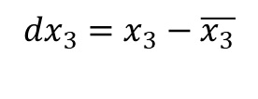
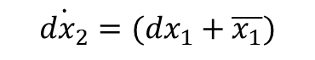
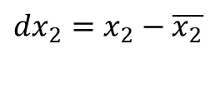
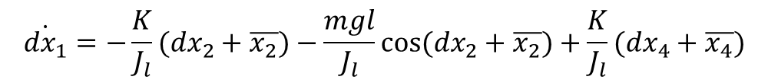
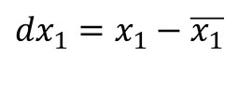
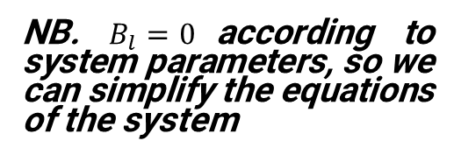
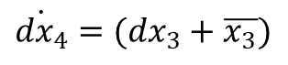
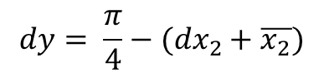
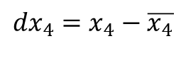
1.2 CHANGE OF COORDINATES
In order to bring the equilibrium to [0 0 0 0], we must set:
$${dx}_{1}=x_{1}−\overline{x_{1}}$$
$$\dot{{dx}_{1}}=−\frac{K}{J_{l}}({dx}_{2}+\overline{x_{2}})−\frac{mgl}{J_{l}}cos⁡({dx}_{2}+\overline{x_{2}})+\frac{K}{J_{l}}({dx}_{4}+\overline{x_{4}})$$
$${dx}_{2}=x_{2}−\overline{x_{2}}$$
$$\dot{{dx}_{2}}=({dx}_{1}+\overline{x_{1}})$$
$${dx}_{3}=x_{3}−\overline{x_{3}}$$
$$\dot{x_{3}}=\frac{K}{J_{m}}({dx}_{2}+\overline{x_{2}})−\frac{B_{m}}{J_{m}}({dx}_{3}+\overline{x_{3}})−\frac{K}{J_{m}}({dx}_{4}+\overline{x_{4}})+\frac{1}{J_{m}}(u−\overline{u})$$
$${dx}_{4}=x_{4}−\overline{x_{4}}$$
$$\dot{{dx}_{4}}=({dx}_{3}+\overline{x_{3}})$$
NB. $B_{l}=0$according to system parameters, so we can simplify the equations of the system
$$dy= \frac{π}{4}−({dx}_{2}+\overline{x_{2}})$$

Slide 9
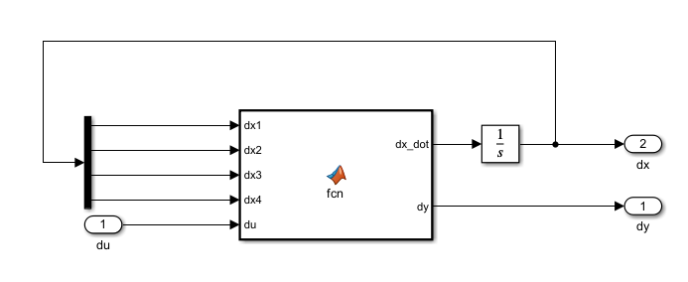
1.3 NONLINEAR SYSTEM SIMULATION
The first task was to perform a simulation of the nonlinear system via Simulink. The aim of this step is basically to verify that the system is unstable, as we can easily expect from such a system.
For the implementation of the system, we opted for a MATLAB function containing the dynamical equations of the system.

Slide 10
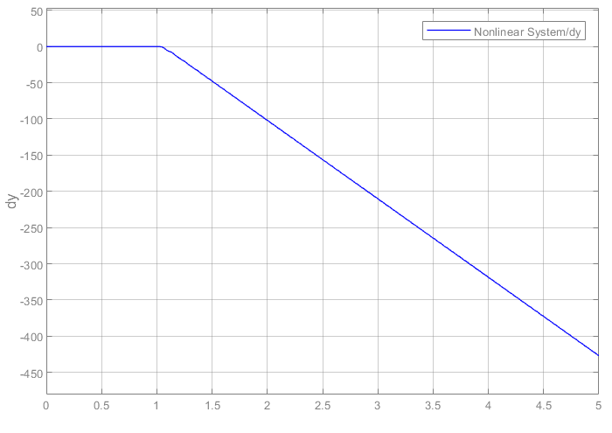
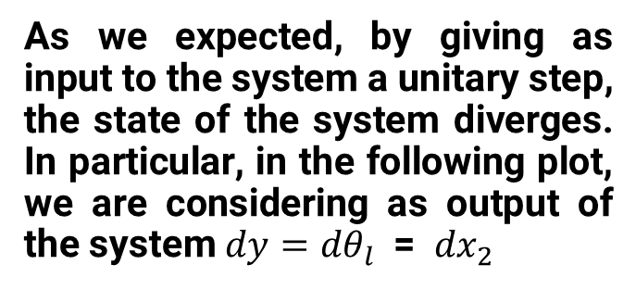
1.3.1 SIMULATION RESULTS
As we expected, by giving as input to the system a unitary step, the state of the system diverges. In particular, in the following plot, we are considering as output of the system ${dy=dθ}_{l}$ = ${dx}_{2}$

Slide 11
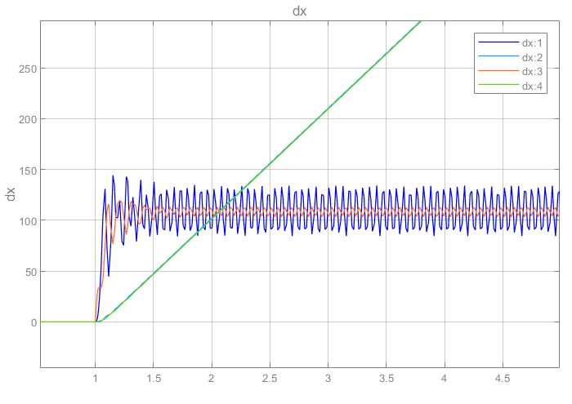
1.3.1 SIMULATION RESULTS
Looking at the other states, we see that also the position of the other link diverges and the velocities of both of them start oscillating

Slide 12
2. SYSTEM LINEARIZATION AND STABILIZATION CONTROL SCHEME
In this part of the task, the aim was to linearize the system and synthetize a controller on it, with the final goal of stabilizing the real nonlinear system.

Slide 13
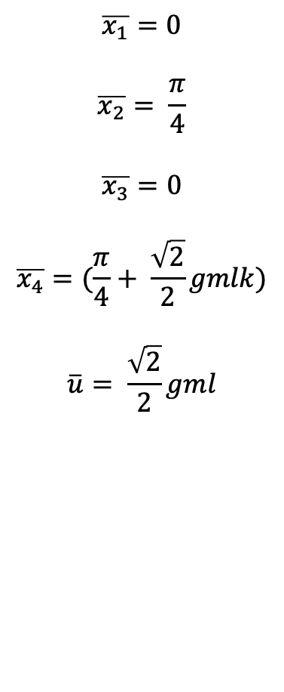
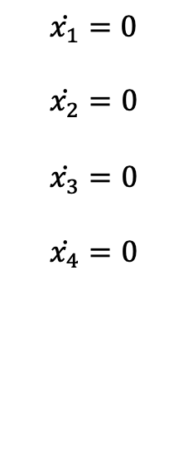
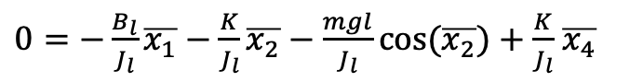

2.1 EQUILIBRIUM
Firstly we need to find the equilibrium of the system corresponding to $x2=\frac{π}{4}$
$$\overline{x_{1}}=0$$
$$\overline{x_{2}}= \frac{π}{4}$$
$$\overline{x_{3}}=0$$
$$\overline{x_{4}}=(\frac{π}{4}+ \frac{\sqrt{2}}{2}gmlk)$$
$$\overline{u}= \frac{\sqrt{2}}{2}gml$$
$$\dot{x_{1}}=0$$
$$\dot{x_{2}}=0$$
$$\dot{x_{3}}=0$$
$$\dot{x_{4}}=0$$
$0=−\frac{B_{l}}{J_{l}}\overline{x_{1}}−\frac{K}{J_{l}}\overline{x_{2}}−\frac{mgl}{J_{l}}cos⁡(\overline{x_{2}})+\frac{K}{J_{l}}$ $\overline{x_{4}}$
$0 =\overline{x_{1}}$
$$0 =\frac{K}{J_{m}}\overline{x_{2}}−\frac{B_{m}}{J_{m}}\overline{x_{3}}−\frac{K}{J_{m}}\overline{x_{4}}+\frac{1}{J_{m}}\overline{u}$$
$$0 =\overline{x_{3}}$$

Slide 14
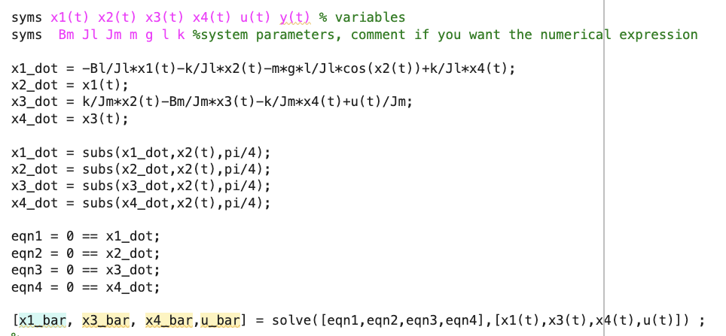
2.1 EQUILIBRIUM
Firstly we need to find the equilibrium of the system corresponding to $x2=\frac{π}{4}$
$$\overline{x_{1}}=0$$
$$\overline{x_{2}}= \frac{π}{4}$$
$$\overline{x_{3}}=0$$
$$\overline{x_{4}}=(\frac{π}{4}+ \frac{\sqrt{2}}{2}gmlk)$$
$$\overline{u}= \frac{\sqrt{2}}{2}gml$$

Slide 15
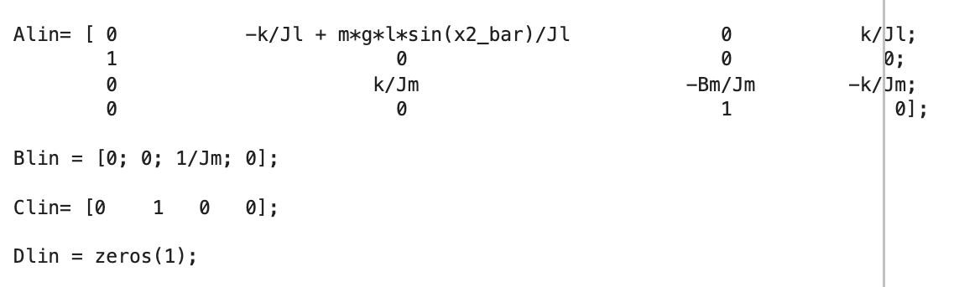
2.2 LINEARIZATION
Once the equilibrium point has been identified, we can move forward with linearizing the system and establishing its matrices.

Slide 16
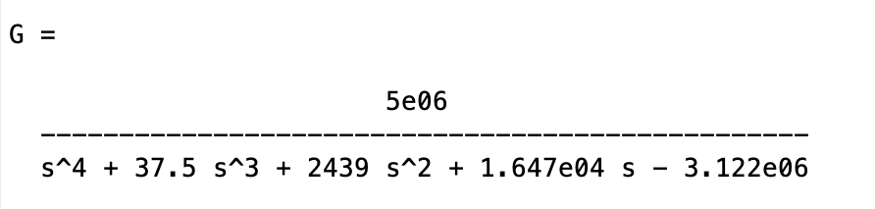
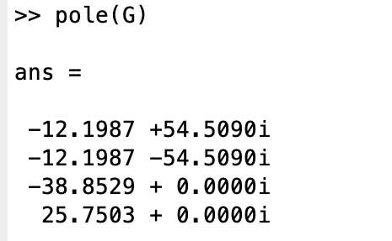
2.3 STABILIZING STATE FEEDBACK CONTROL LAWS
The transfer function G(s) of the linearised system has :
4 poles
No zeros
No integral action

Slide 17
3. IMPLEMENTATION OF THE CONTROL SCHEME ON REAL SYSTEM
In this section, we used Simulink in order to simulate the behavior of the controllers on both the linearized and the real system.

Slide 18
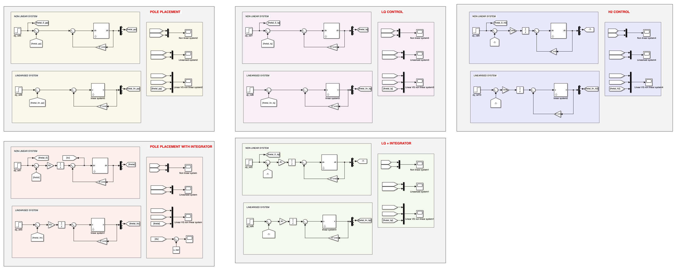
3.1 STABILIZING STATE FEEDBACK CONTROL LAWS

Slide 19
3.1.1 POLE PLACEMENT WITH INTEGRATORS

Slide 20
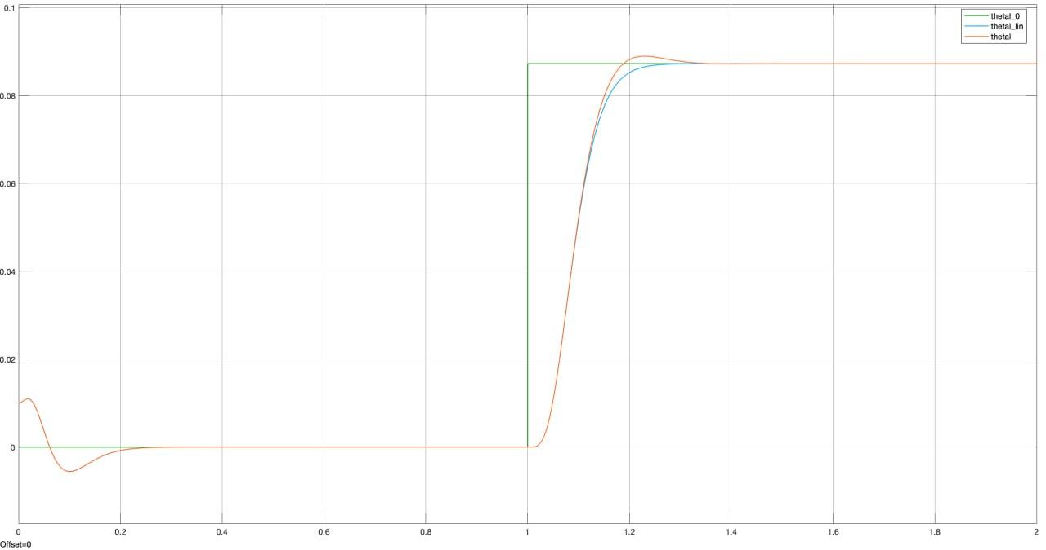
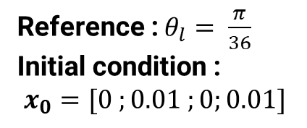
3.1.1 POLE PLACEMENT WITH INTEGRATORS
Reference : $θ_{l}= \frac{π}{36}$
Initial condition :
$x_{0}=[0 ;0.01 ;0;0.01]$

Slide 21
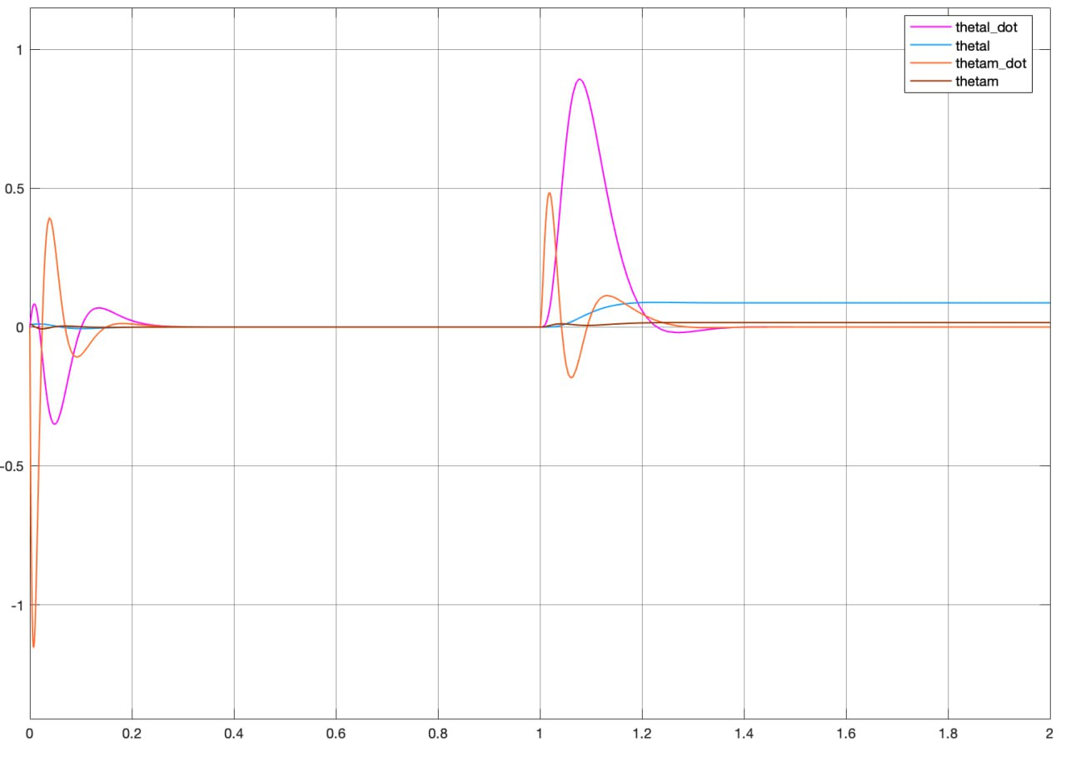
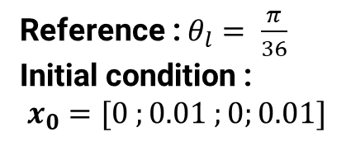
3.1.1 POLE PLACEMENT WITH INTEGRATORS
Reference : $θ_{l}= \frac{π}{36}$
Initial condition :
$x_{0}=[0 ;0.01 ;0;0.01]$

Slide 22
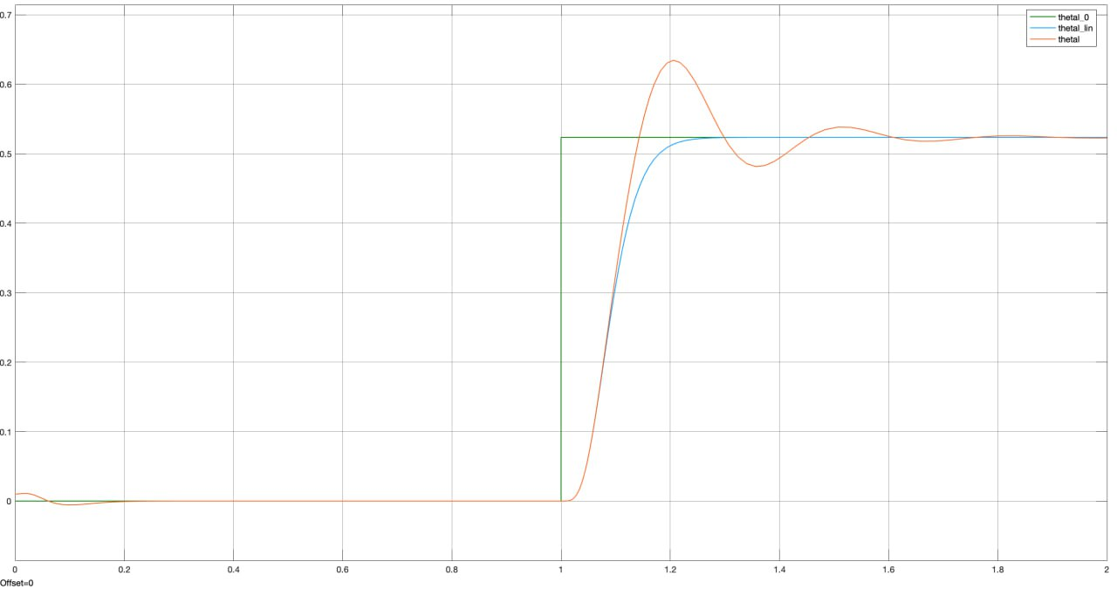

3.1.1 POLE PLACEMENT WITH INTEGRATORS
Reference : $θ_{l}= \frac{π}{6}$

Slide 23
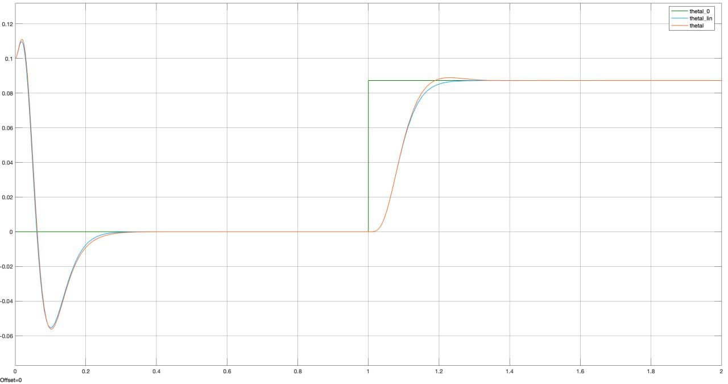
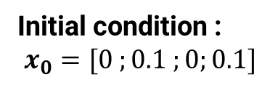
3.1.1 POLE PLACEMENT WITH INTEGRATORS
Initial condition :
$x_{0}=[0 ;0.1 ;0;0.1]$

Slide 24
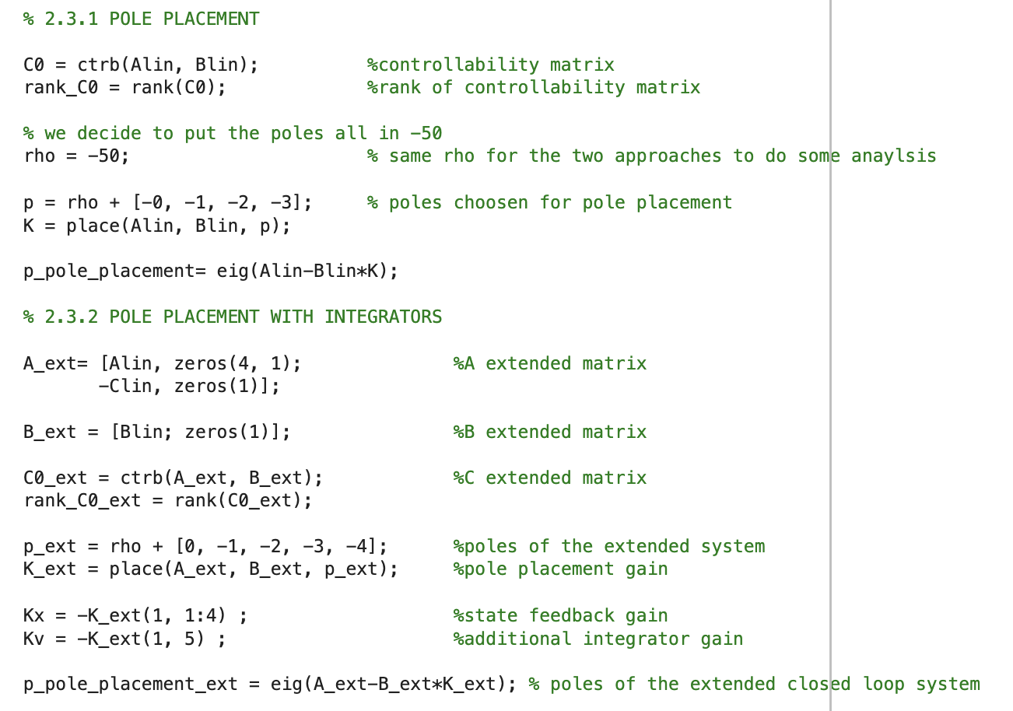
3.1.1 POLE PLACEMENT WITH INTEGRATORS

Slide 25
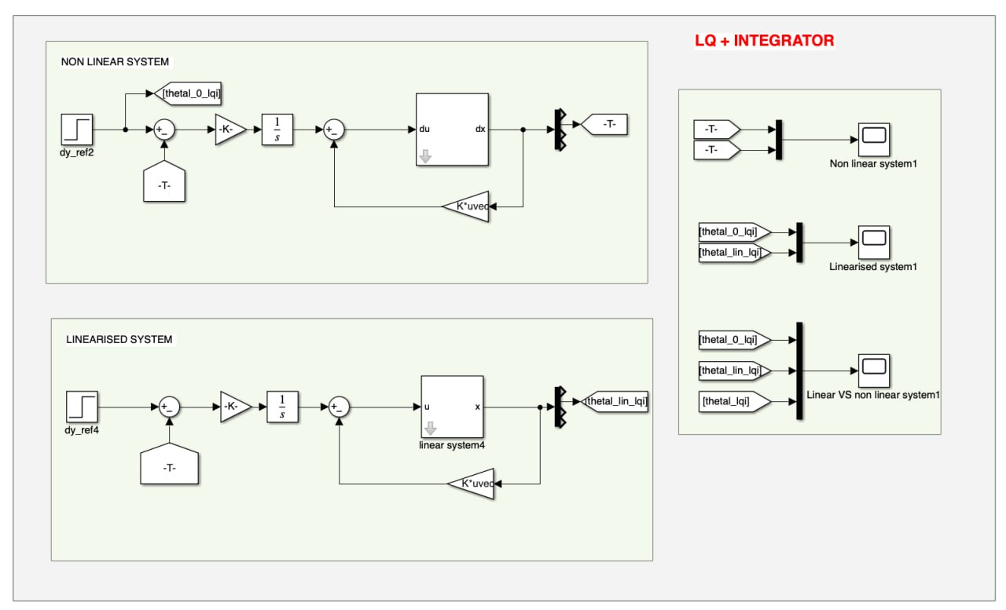
3.1.2 LINEAR QUADRATIC CONTROL WITH INTEGRATOR

Slide 26
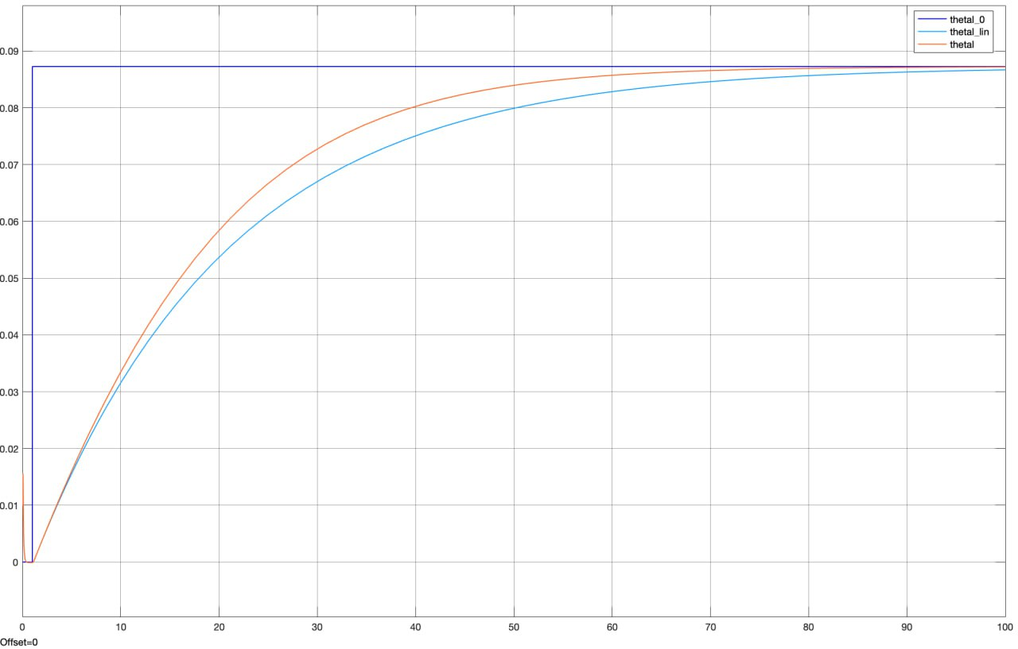
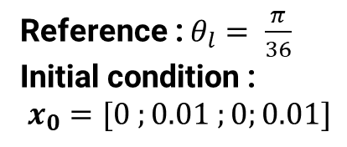
3.1.2 LINEAR QUADRATIC CONTROL WITH INTEGRATOR
Reference : $θ_{l}= \frac{π}{36}$
Initial condition :
$x_{0}=[0 ;0.01 ;0;0.01]$

Slide 27
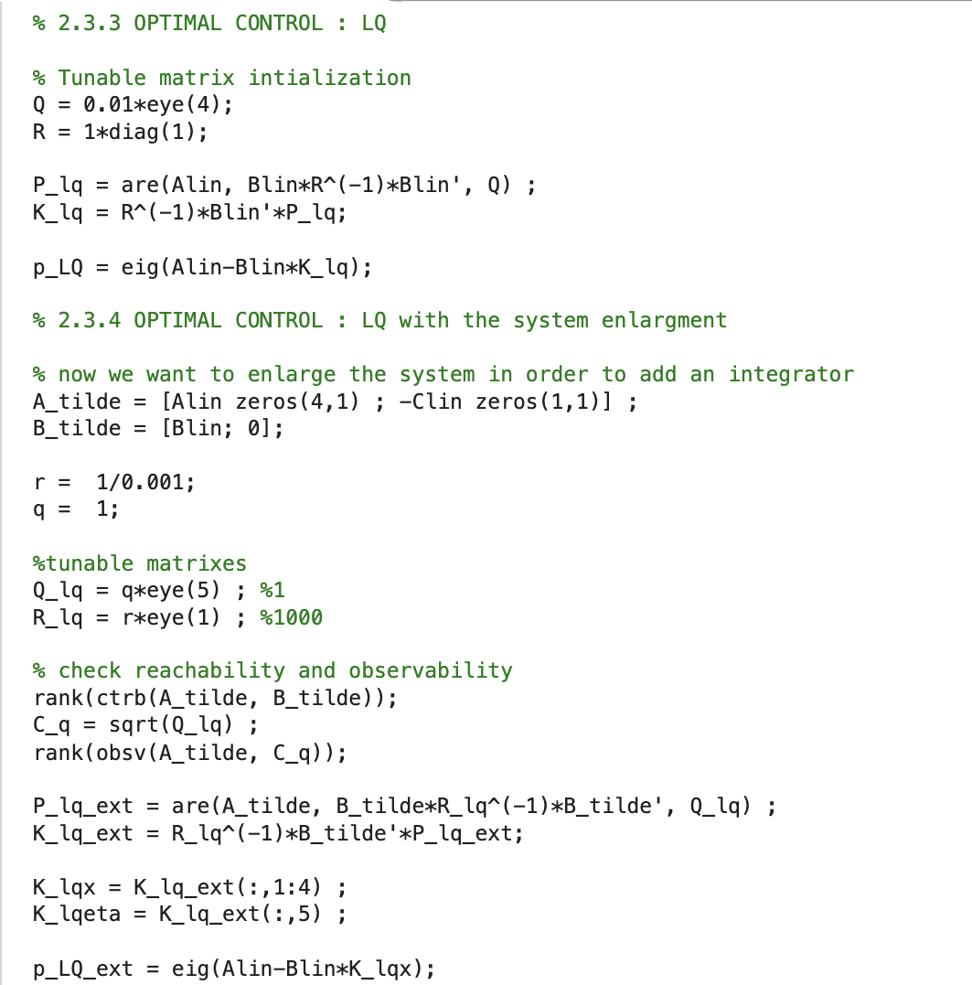
3.1.2 LINEAR QUADRATIC CONTROL WITH INTEGRATOR

Slide 28
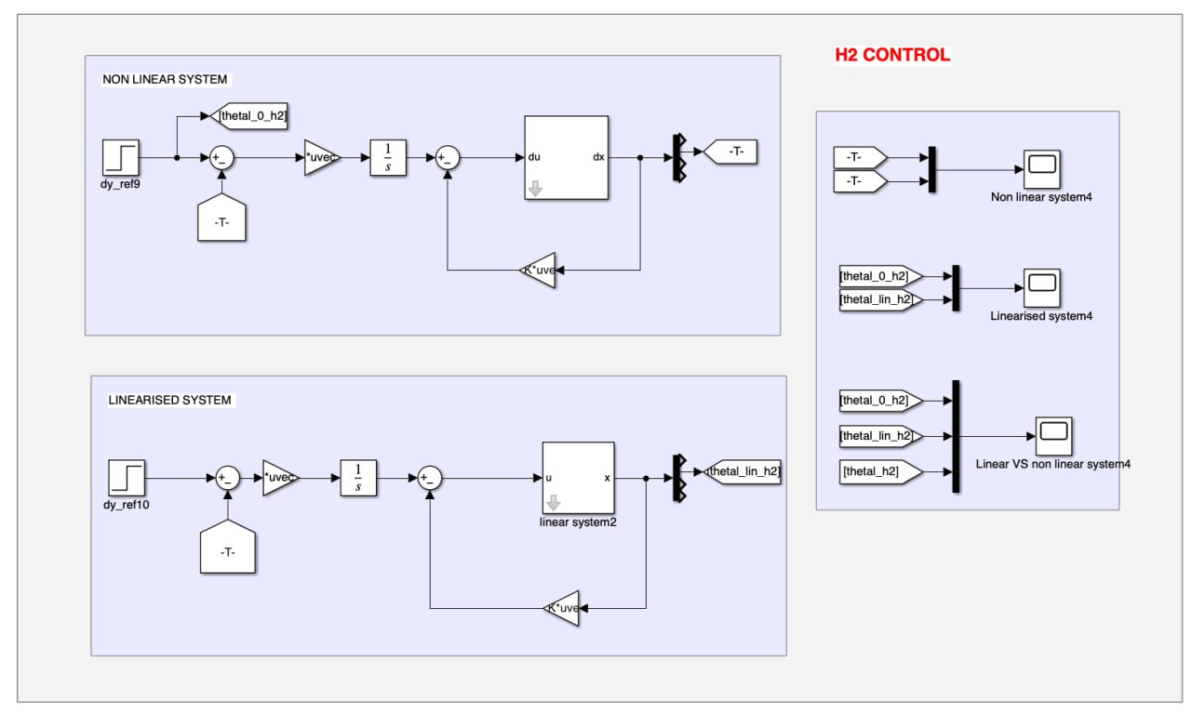
3.1.3 H2 CONTROL

Slide 29
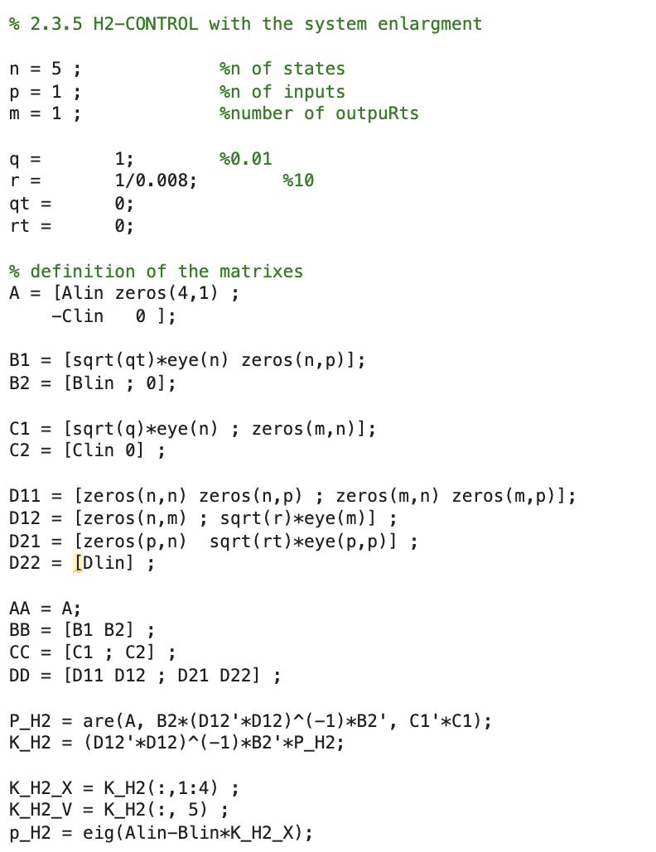
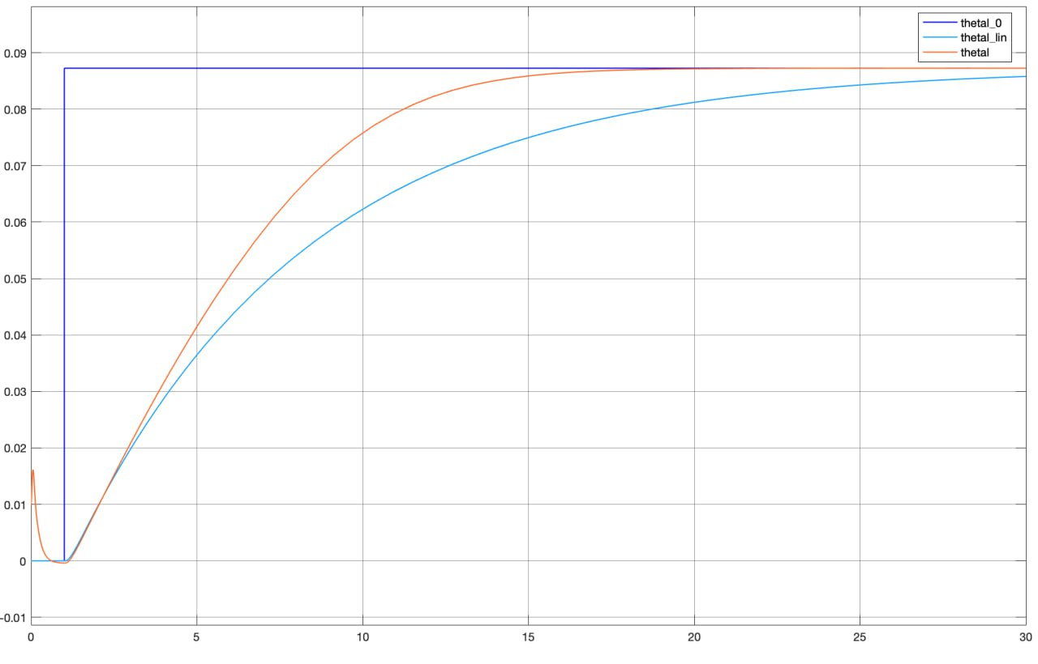
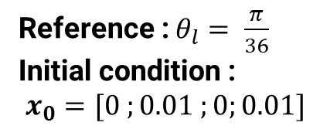
3.1.3 H2 CONTROL
Reference : $θ_{l}= \frac{π}{36}$
Initial condition :
$x_{0}=[0 ;0.01 ;0;0.01]$

Slide 30
4. FEEDBACK LINEARIZATION
In this section, we used MATLAB Symbolic toolbox in order to get the parametric equations involved in the feedback linearization process.

Slide 31
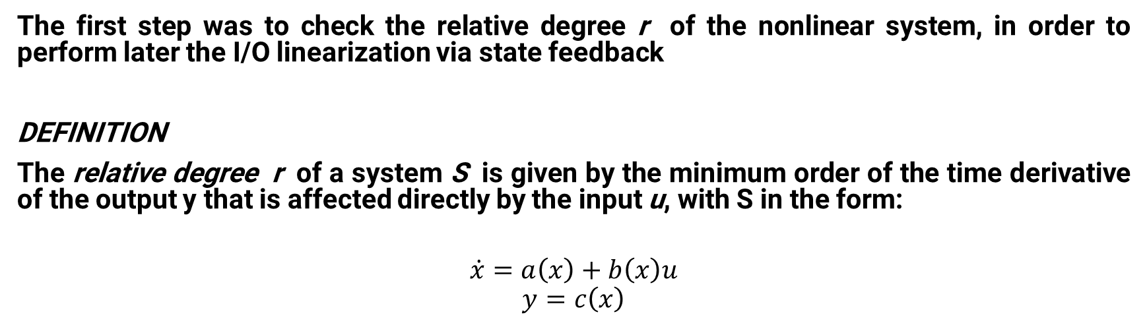
4.1 CHECKING THE RELATIVE DEGREE
The first step was to check the relative degree r of the nonlinear system, in order to perform later the I/O linearization via state feedback
DEFINITION
The relative degree r of a system S is given by the minimum order of the time derivative of the output y that is affected directly by the input u, with S in the form:
$$\dot{x}=a\left(x\right)+b\left(x\right)u$$
$$y=c\left(x\right)$$

Slide 32
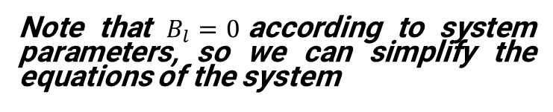




4.1 CHECKING THE RELATIVE DEGREE
In our case, we get:
Note that $B_{l}=0$according to system parameters, so we can simplify the equations of the system
$$y={\frac{π}{4}−x}_{2}→ r=0$$
$\dot{y}=−\dot{x_{2} }=−x_{1}→r=$1
$\ddot{y}=−\dot{x_{1}}$ = $\frac{K}{J_{l}}x_{2}+\frac{mgl}{J_{l}}{cos⁡(x}_{2})−\frac{K}{J_{l}}x_{4} →r=2$
$\overset{⃛}{y}=$ $\frac{k}{J_{l}}x_{1}−\frac{mgl}{J_{l}}{sin⁡(x}_{2})x_{1}−\frac{K}{J_{l}}x_{3}→r=3$
$\ddot{y}\ddot{ }=$ $\frac{k}{J_{l}}{(\frac{k}{J_{l}}x}_{2}−\frac{mgl}{J_{l}}{cos⁡(x}_{2})+\frac{K}{J_{l}}x_{4})−\frac{mgl}{J_{l}}{cos⁡(x}_{2})x_{1}^{2}−\frac{mgl}{J_{l}}{sin⁡(x}_{2})(−{\frac{k}{J_{l}}x}_{2}−\frac{mgl}{J_{l}}{cos⁡(x}_{2})+\frac{K}{J_{l}}x_{4})−\frac{k}{J_{l}}{(\frac{k}{J_{m}}x}_{2}−{\frac{B_{m}}{J_{m}}x}_{3}−\frac{k}{J_{m}}x_{4}+\frac{u}{J_{m}})→r=4$

Slide 33

4.1 CHECKING THE RELATIVE DEGREE
The relative degree check was possible thanks to the subs command inside the Symbolic toolbox:
In particular, we defined an iterative method in which we substitute to all the states 0 and to u a value different from 0 (1). If the computation of the sostitution is 0, then the rd has incremented wrt to the previous step (since it means that it does not depend from u), otherwise we arrived to the final rd.

Slide 34

4.2 CHANGE OF COORDINATES
In order to bring the equilibrium to [0 0 0 0], we must set:
$${dx}_{1}=x_{1}−\overline{x_{1}}$$
$$\dot{{dx}_{1}}=−\frac{K}{J_{l}}({dx}_{2}+\overline{x_{2}})−\frac{mgl}{J_{l}}cos⁡({dx}_{2}+\overline{x_{2}})+\frac{K}{J_{l}}({dx}_{4}+\overline{x_{4}})$$
$${dx}_{2}=x_{2}−\overline{x_{2}}$$
$$\dot{{dx}_{2}}=({dx}_{1}+\overline{x_{1}})$$
$${dx}_{3}=x_{3}−\overline{x_{3}}$$
$$\dot{x_{3}}=\frac{K}{J_{m}}({dx}_{2}+\overline{x_{2}})−\frac{B_{m}}{J_{m}}({dx}_{3}+\overline{x_{3}})−\frac{K}{J_{m}}({dx}_{4}+\overline{x_{4}})+\frac{1}{J_{m}}(u−\overline{u})$$
$${dx}_{4}=x_{4}−\overline{x_{4}}$$
$$\dot{{dx}_{4}}=({dx}_{3}+\overline{x_{3}})$$
NB. $B_{l}=0$according to system parameters, so we can simplify the equations of the system
$$dy= \frac{π}{4}−({dx}_{2}+\overline{x_{2}})$$

Slide 35

4.2 DIFFEOMORPHISM
The equations of the diffeomorphism are:
$$\tilde{x_{1}}=−dx_{2}$$
$$\tilde{x2}=−dx1$$
$$\tilde{x_{3}}=\frac{k{(dx}_{4}+(\frac{π}{4}+\frac{\sqrt{2}}{2}mgl)}{kJl}−\frac{k\left(\frac{π}{4}+{dx}_{2}\right)}{Jl}−\frac{mglcos⁡(dx_{2}+\frac{π}{4}) }{Jl}$$
$$\tilde{x_{4}}=\frac{kdx_{3}}{Jl}−\frac{k{dx}_{1}}{Jl}+\frac{mglsin\left(\frac{π}{4}+dx_{2}\right)dx_{1}}{Jl}$$

Slide 36


4.3 RANK OF THE JACOBIAN
In order to verify if the diffeomorphism is well defined over the entire $R^{4}$, we need to compute the Jacobian and check if it is full rank. We implemented this part on MATLAB, with the following lines of code:

Slide 37
4.4 FINDING U
In order to find u now, we need to put v equal to and then reverse the equation in order to find u. In our code v is written in the explicitly in order to enhance it’s expression and obtain directly the expression of u.

Slide 38


4.2 STABILIZING CONTROL-LAW on the feedback linearized system
Once the state-feedback linearized control law is placed, the dynamic relation between the new input v and the output dy is described by a four-th order integrator

Slide 39

4.2 STABILIZING CONTROL-LAW on the feedback linearized system
The control scheme is articulated into two steps:
Pole Placement controller
LTI controller
v2

Slide 40


4.2 STABILIZING CONTROL-LAW on the feedback linearized system
Pole Placement controller
State space representation of the four-th order integrator

Slide 41



4.2 STABILIZING CONTROL-LAW on the feedback linearized system
2. LTI controller
PI controller over the Pole-Placement controller
$w_{c}=3 \left[\frac{rad}{s}\right] phi_{m}=76.6583$°

Slide 42


4.2 STABILIZING CONTROL-LAW on the feedback linearized system
3. Final controller:
Linear controller

Slide 43

4.2 STABILIZING CONTROL-LAW on the feedback linearized system
3. Final result:

Slide 44
5. ANALYSIS OF THE RESULTS

Slide 45

5 STABILIZING CONTROL-LAW on the feedback linearized system
Simulation and Test:
dx_0 = [0;1;0;1]*0.01;
dy_ref(t) = 1*step(t-1.5)

Slide 46
6. VARIABLE STRUCTURE CONTROLLER
Starting from the system linearized through feedback linearization, let's call it S, we aim to build a variable structure controller to make y(t) track some (constant) reference signal y°.

Slide 47

6.1 SYSTEM S
System S is defined as follows, where v is the input:
Notice that the system is in the controllable canonical form, if it was not we would have to apply a trasformation.
Next step is to determine a suitable switching function

Slide 48



6.2 DETERMINING A SWITCHING FUNCTION AND SYSTEM S*
A typical choice for the switching function is:
To find the sliding surface we just set the previous expression equal to zero:
Let's explicit with respect to the 4th state component since it's the one containing the input:
Doing so, we get the system S* (of reduced order) which evolves restricted by the sliding surface.

Slide 49




6.3 CHARACTERISTIC POLYNOMIAL AND EQUILIBRIUM
The polynomial on the right characterizes the evolution of the system along the sliding surface, we assign its roots in order to achieve a desired behaviour. The assignment is merely done via matching with the coefficient of another polynomial with the desired roots.
We chose to set the 3 poles in –10:
Next step is to find the equilibrium of S*, which leads us to:
(we set the y at the equilibrium to be our reference y°)
We define gamma:
(b4 is = 1 in the case under study)

Slide 50




6.4 DETERMINING A CONTROL LAW
To determine a control law of the type:
We followed the 'reaching-law approach’
The dynamics of the switching function is given by:
The time required to reach s=0 is:
Final control law:

Slide 51

6.5 MATLAB SCRIPT

Slide 52

6.6 SIMULINK SCHEME

Slide 53
7. VSC PERFORMANCE WRT CHANGE OF CONDITIONS
Analysis to high frequency switching of the control variable and sinusoidal disturbance.

Slide 54


7.1 HIGH FREQUENCY SWITCHING
To treat the problem of high frequency switching we put an integrator on v:
That means we extend the state(we add the state u).
And proceed to work with a system that is now extended, see the matlab code.

Slide 55

7.1 HIGH FREQUENCY SWITCHING
In the image (ZOOMED IN) is represented the control variable v:
Yellow, base case;
Blue, with integrator;
We can immediately appreciate how the integrator helps with avoiding the high frequency switching

Slide 56

7.1 HIGH FREQUENCY SWITCHING

Slide 57




7.2 SINUSOIDAL LOAD DISTURBANCE
From the theory we know that setting a q with value higher of the disturbance amplitude W, the state will still converge to the sliding surface.
Only the time to reach it will be affected (increasing due to W):
The red signal is the control variable v when the system is affected by a sinusoidal disturbance

Slide 58

7.2 SINUSOIDAL LOAD DISTURBANCE

Slide 59




THANKS FOR THE ATTENTION
Alex Zagati
10658724
Kevin Carrion
10690049
Alexandra Spertini
10664658
Matteo Mastromauro
10680859

